Slide 1
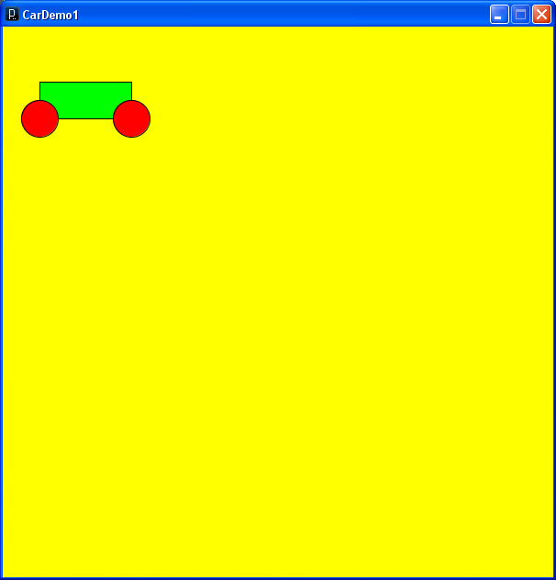
CarDemo1
Car
= Body
+ 2 Wheels
Use a Block to model the body and Circles to model the wheels.
Using classes to model complex objects
Car
Block
Circle
Class Structure
11/10/09

Slide 2
class Circle {
int Cx,
Cy;
int dx,
dy;
int D;
color FillCol;
Circle(int Cx, int Cy, int D) {
this.Cx = Cx;
this.Cy = Cy;
this.D = D;
}
// PRE TRUE
// POST Circle drawn on canvas
void Draw() {
fill(FillCol);
ellipse(Cx, Cy, D, D);
}
// PRE TRUE
// POST Moves this (dx, dy)
void Move() {
Cx += dx;
Cy += dy;
}
}
CarDemo1
Let’s be good software engineers and reuse Circle!
11/10/09

Slide 3
class Block {
int Lx,
Ty;
int W,
H;
int dx,
dy;
color FillCol;
Block(int Lx, int Ty, int W, int H) {
this.Lx = Lx;
this.Ty = Ty;
this.dx = dx;
this.dy = dy;
this.W = W;
this.H = H;
this.FillCol = FillCol;
}
// PRE TRUE
// POST Block drawn on canvas
void Draw() {
fill(FillCol);
rect(Lx, Ty, W, H);
}
// PRE TRUE
// POST Moves this (dx, dy)
void Move() {
Lx += dx;
Ty += dy;
}
}
CarDemo1
Block is implemented using the Processing rect() method and Draw() and Move() methods similar to those of Circle
11/10/09

Slide 4
CarDemo1
Our Car is defined by
Where we want it to be - Lx and Ly
The size of the Block – W and H
The radius of the Circles for wheels WR
The colour of the Block BCol
The colour of the Circles for wheels WCol
Once we know these values we can draw it on paper.
class Car {
Block Body;
Circle Wheel1,
Wheel2;
Car(int Lx, int Ty, int W, int H, int WR, int BCol, int WCol) {
Body = new Block(Lx, Ty, W, H);
Wheel1 = new Circle(Lx, Ty + H, 2 * WR);
Wheel2 = new Circle(Lx + W, Ty + H, 2 * WR);
Body.FillCol = BCol;
Wheel1.FillCol = WCol;
Wheel2.FillCol = WCol;
}
void Draw() {
Body.Draw();
Wheel1.Draw();
Wheel2.Draw();
}
}
The constructer method for Car uses the constructor method for Block and Circle, which are already defined.
Since we already know how get Processing to draw a Block and a Circle the Draw() method for Car just calls these methods on the components of Car.
11/10/09

Slide 5
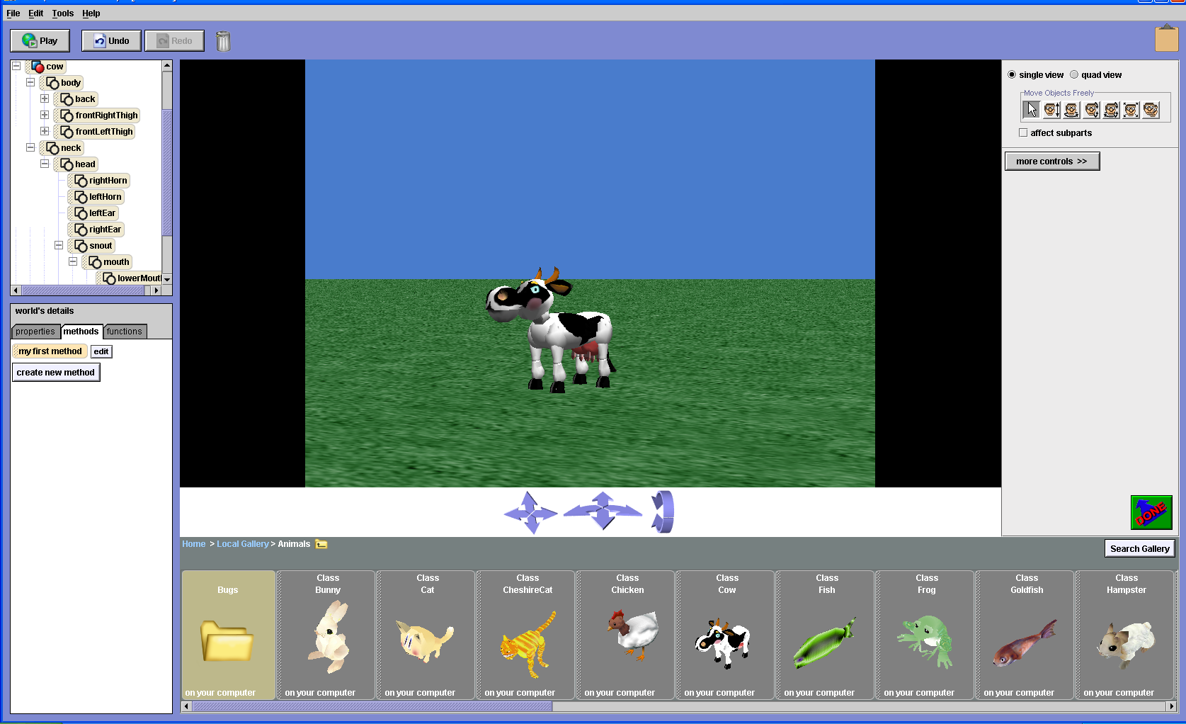
CarDemo1
Mooo! I am a cow of many parts!
Brmm! Brmm! And I am a Car of (not quite so) many parts!
Car
class Car {
Block Body;
Circle Wheel1,
Wheel2;
11/10/09
Block
Circle

Slide 6
CarDemo1
class Car {
Block Body;
Circle Wheel1,
Wheel2;
Car(int Lx, int Ty, int W, int H, int WR, int BCol, int WCol) {
Body = new Block(Lx, Ty, W, H);
Wheel1 = new Circle(Lx, Ty + H, 2 * WR);
Wheel2 = new Circle(Lx + W, Ty + H, 2 * WR);
Body.FillCol = BCol;
Wheel1.FillCol = WCol;
Wheel2.FillCol = WCol;
}
void Draw() {
Body.Draw();
Wheel1.Draw();
Wheel2.Draw();
}
}
Car
11/10/09
Block
Circle

Slide 7
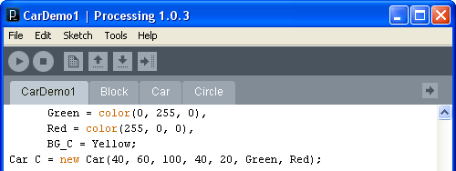
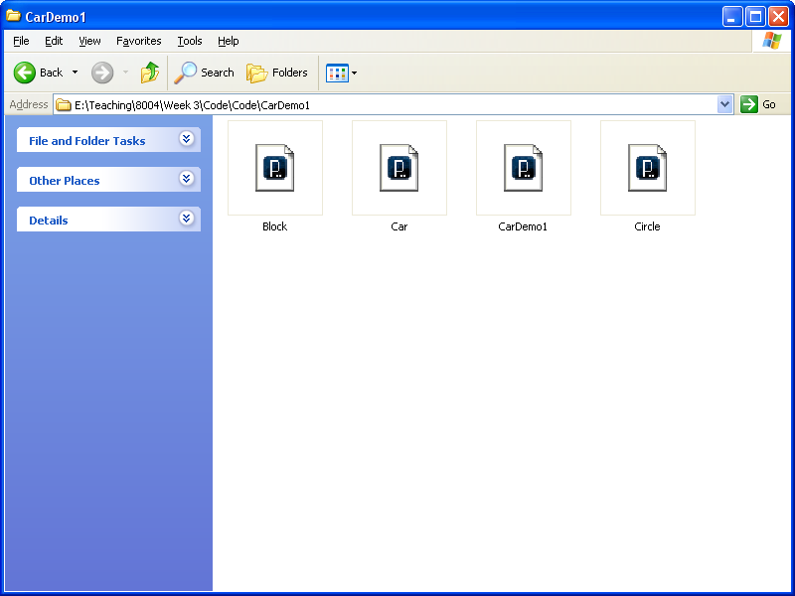
int Diameter = 30;
int W = 600,
H = 600;
int xC = 300,
yC = 300;
int dx = 3,
dy = 1;
PFont font;
color Yellow = color(255, 255, 0),
Green = color(0, 255, 0),
Red = color(255, 0, 0),
BG_C = Yellow;
Car C = new Car(40, 60, 100, 40, 20, Green, Red);
void setup() {
size(W, H);
smooth();
fill(Green);
}
void draw() {
background(BG_C);
C.Draw();
}
CarDemo1
CarDemo1
Note that the main program CarDemo1 does not deal with Blocks or Wheels directly
Car
11/10/09
Block
Circle

Slide 8
CarDemo2
class Car {
Block Body;
Circle Wheel1,
Wheel2;
Car(int Lx, int Ty, int W, int H, int WR, color BCol, color WCol) {
………………………………………
}
void Draw() {
………………………………….
}
void Set_Velocity(int dx, int dy) {
Body.dx = dx;
Body.dy = dy;
Wheel1.dx = dx;
Wheel1.dy = dy;
Wheel2.dx = dx;
Wheel2.dy = dy;
}
void Move() {
Body.Move();
Wheel1.Move();
Wheel2.Move();
}
Car
11/10/09
Block
Circle

Slide 9
CarDemo2
……………………………………
void setup() {
size(W, H);
smooth();
fill(Green);
C.Set_Velocity(1, 0);
}
void draw() {
background(BG_C);
C.Draw();
C.Move();
}
CarDemo2
Again the main program – here CarDemo2 - does not deal with Blocks or Wheels directly
Car
11/10/09
Block
Circle

Slide 10
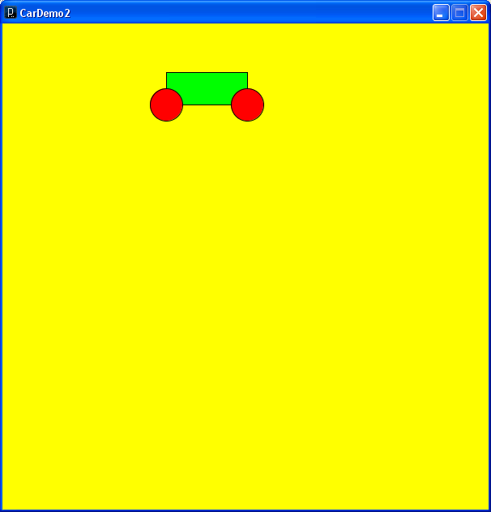

CarDemo2
1
void setup() {
size(W, H);
smooth();
fill(Green);
C.Set_Velocity(1, 0);
}
void draw() {
background(BG_C);
C.Draw();
C.Move();
}
11/10/09

Slide 11
class Car {
Block Body;
Circle Wheel1,
Wheel2;
Car(int Lx, int Ty, int W, int H, int WR, color BCol, color WCol) {
…………………….
}
void Draw() {
………………………….
}
void Set_Velocity(int dx, int dy) {
……………………………….
}
void Move() {
……………………………………………………….
}
void Explode(int v) {
Body.dy = Body.dy -v;
Wheel1.dx = Wheel1.dx - v;
Wheel1.dy = Wheel1.dy + v;
Wheel2.dx = Wheel2.dx + v;
Wheel2.dy = Wheel2.dy + v;
}
}
CarDemo3
11/10/09

Slide 12
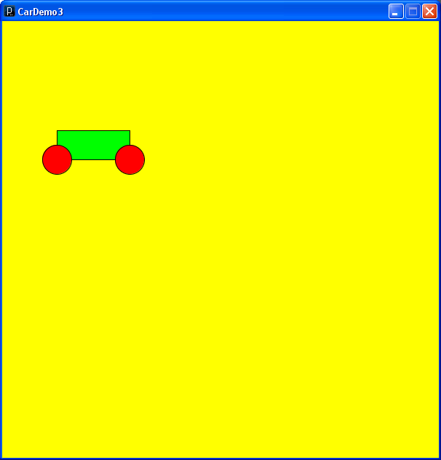
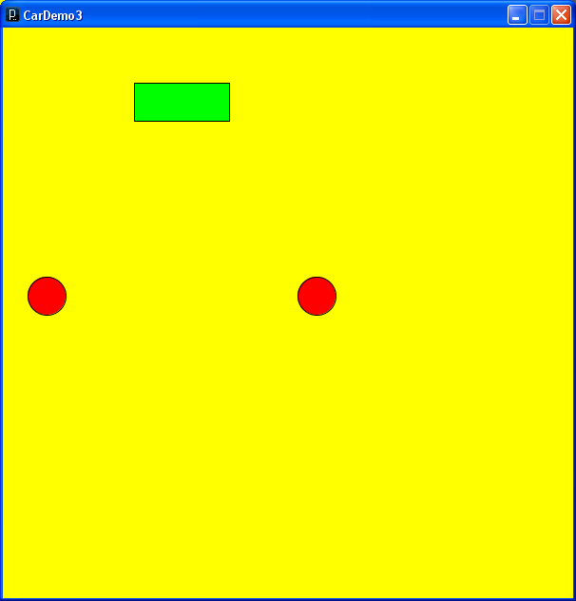

CarDemo3
-v
-v
v
Original velocity +..
v
v
void Explode(int v) {
Body.dy = Body.dy -v;
Wheel1.dx = Wheel1.dx - v;
Wheel1.dy = Wheel1.dy + v;
Wheel2.dx = Wheel2.dx + v;
Wheel2.dy = Wheel2.dy + v;
}
11/10/09

